Slide 1
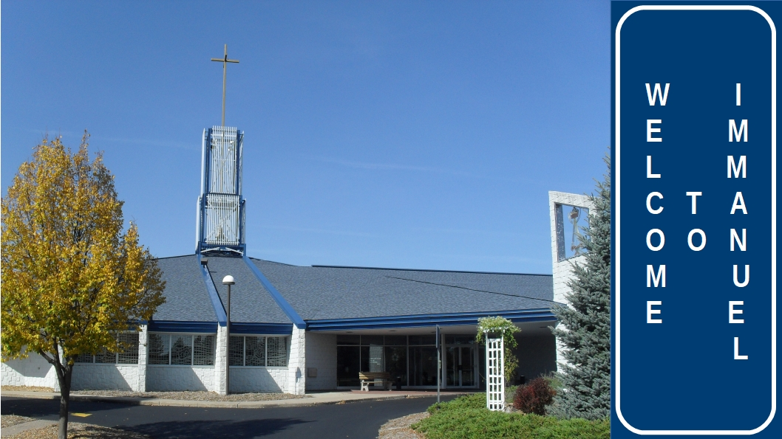

Slide 2


Slide 3
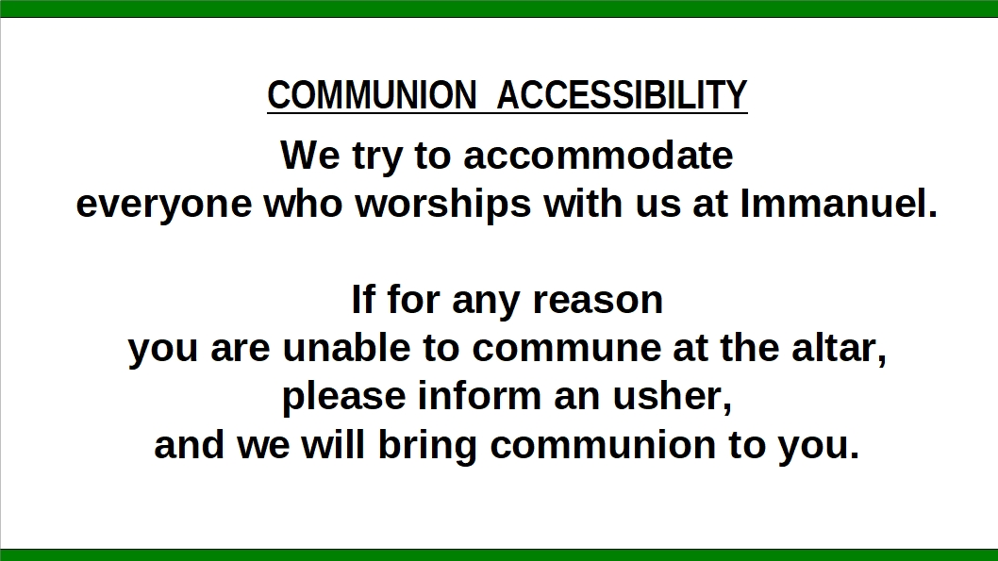

Slide 4


Slide 5
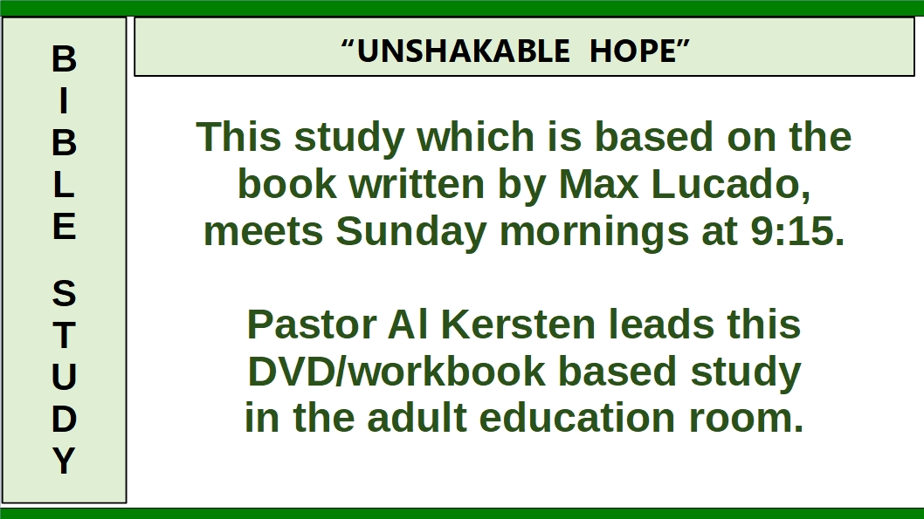

Slide 6


Slide 7
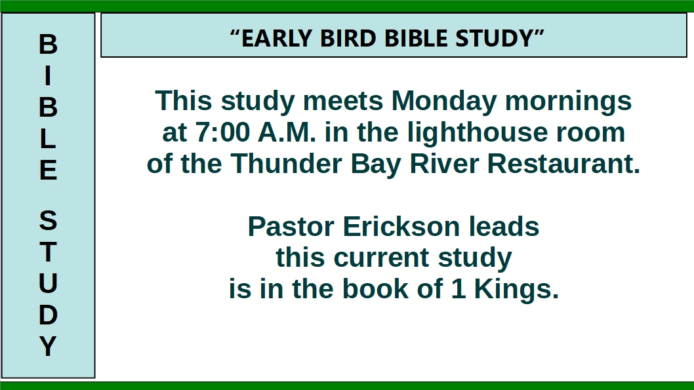

Slide 8
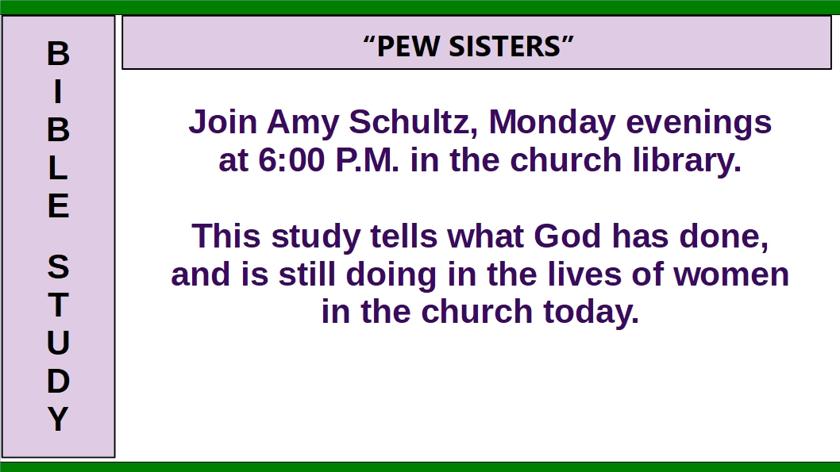

Slide 9
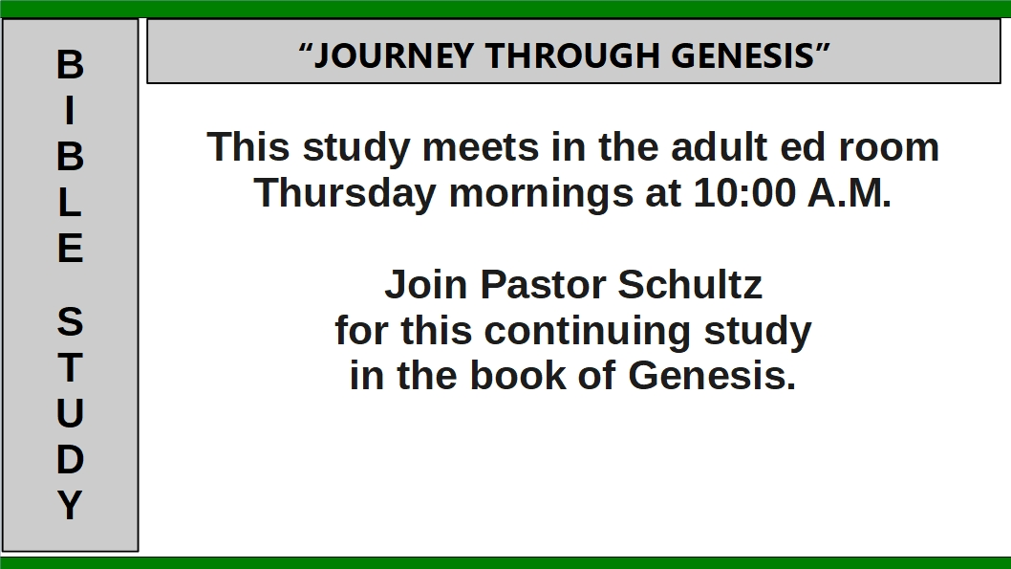

Slide 10


Slide 11


Slide 12

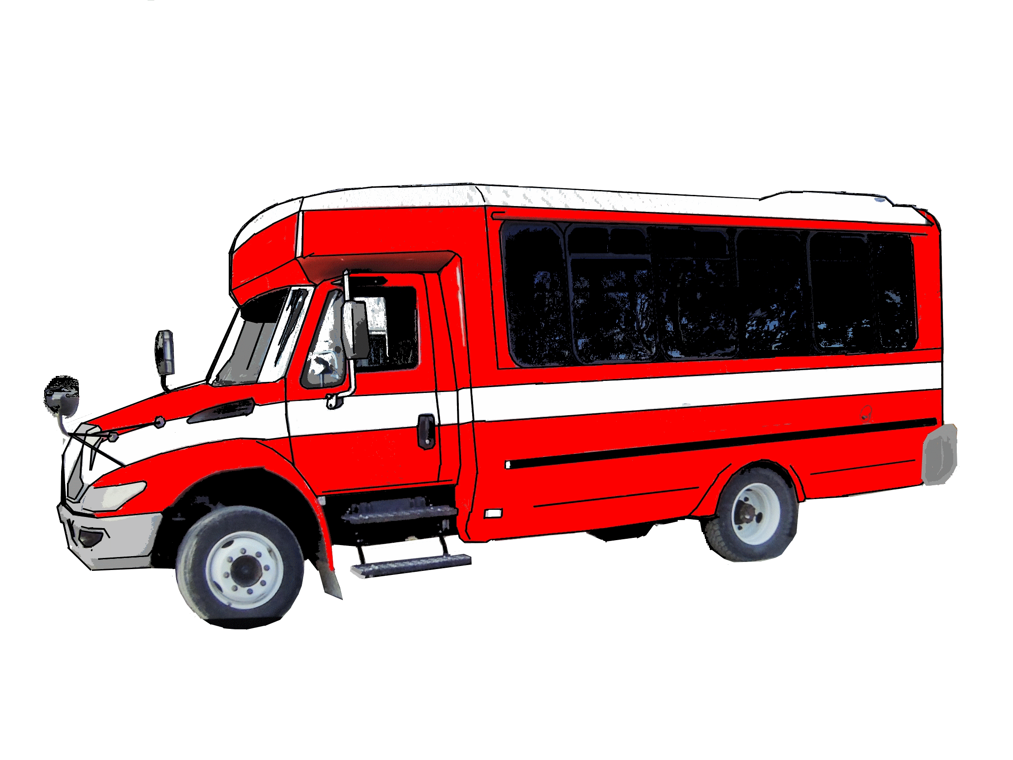

Slide 13
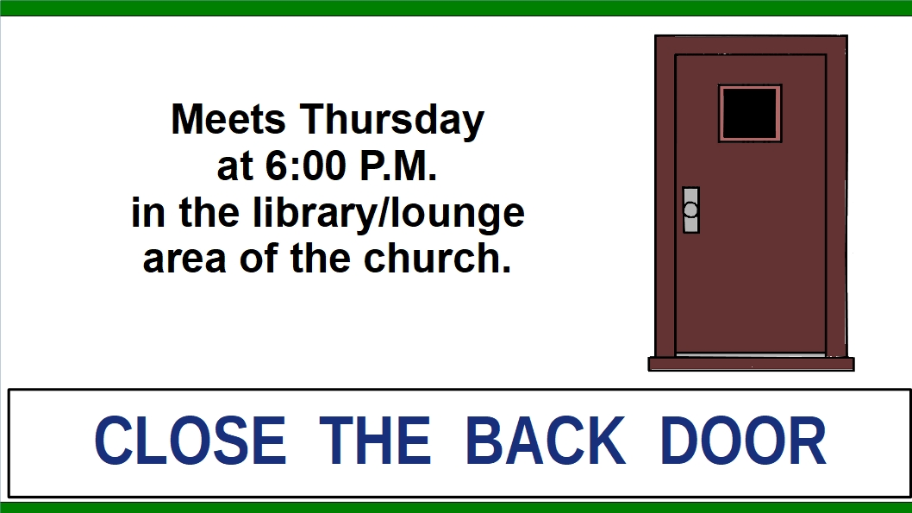

Slide 14
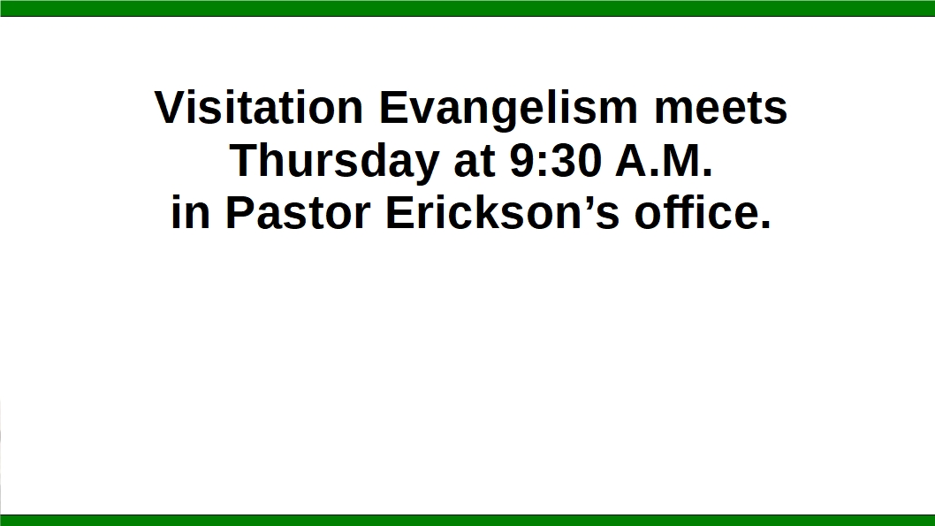
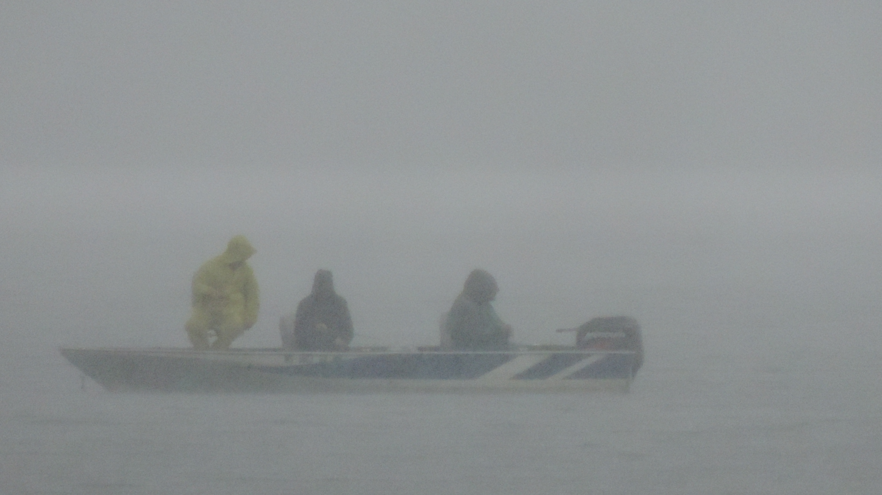

Slide 15


Slide 16
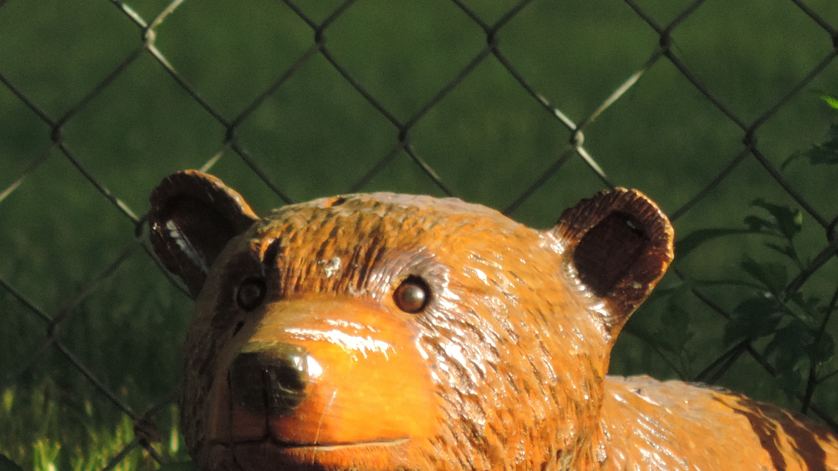
YOUTH GROUP
THURSDAYS at 6:30 p.m.
for Grades 7-12
and
College-age
Photo by N. Hoch

Slide 17


Slide 18


